Slide 1
See, Think, Wonder, & Evaluate

Slide 2
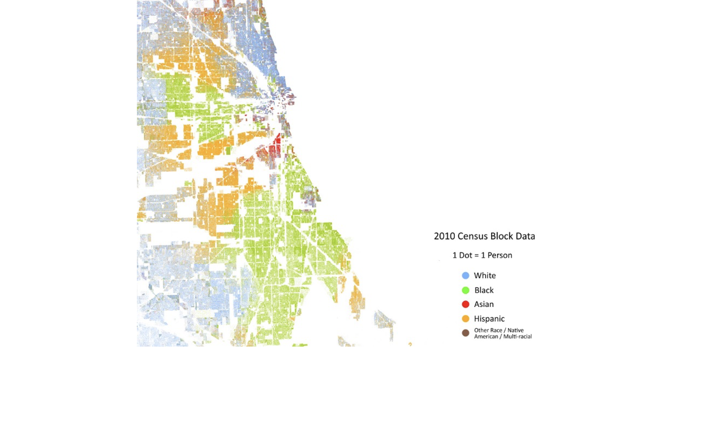

Slide 3
